Slide 1

Dr. Rosemarie Russo
Sustainable Water Management Conference
April 1, 2014
Eventually,
All Things Merge Into One, And A River Runs Through It…
Notes:
A title slide background to enhance your Microsoft PowerPoint presentations.
You can download this design and over 10,000 more at www.presentationpro.com

Slide 2
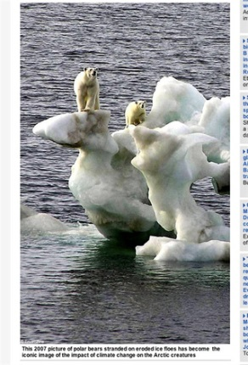
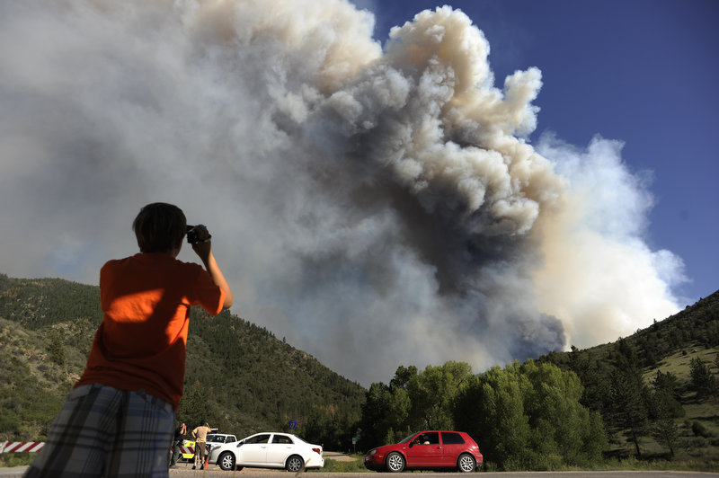
What’s the Point ?
Climate Change affects us and
we can all take action.

Slide 3
Sustainability & Water Resources
Sustainability is the balanced stewardship of human, financial, and environmental resources for present and future generations.

Slide 4
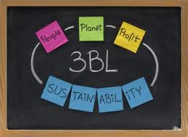
Community Services Delivered
(i.e., electricity and water)
2005 - . 53 metric tons CO2e per citizen
2013 - . 42 metric tons CO2e per citizen

Slide 5



Communicating
Different Audiences

Slide 6
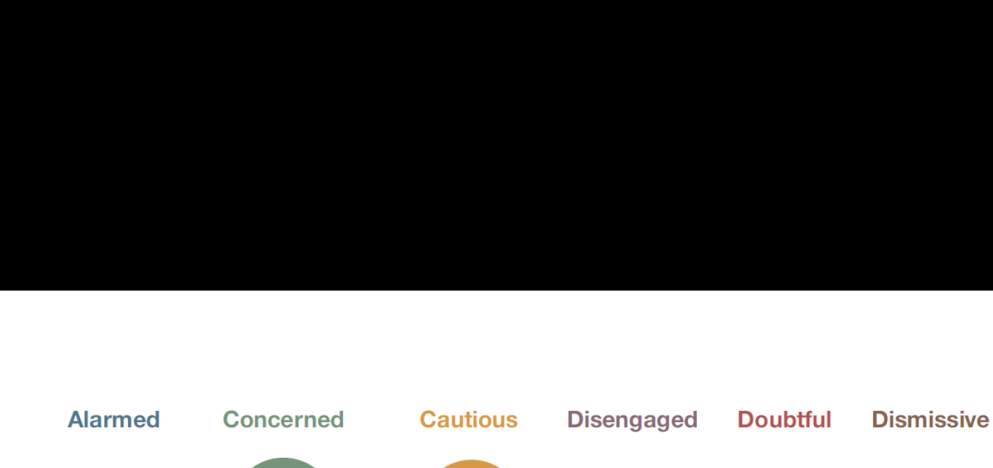
Communication- Choir
Six America’s (Yale)
Alarmed (12%)
Activate them to influence policy/legislation
Cautious (25%)
Move the conversation from debate to risk management
Concerned (27%)
Connections to co-benefits

Slide 7
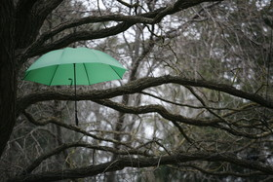
Capture
All You Can
Education about policy changes
Campaign – Rainwater Amendments
Local Policy Changes
Notes:
Gorilla - 23 = 4304 MT – 8,000 lbs
Total footprint (impact)

Slide 8

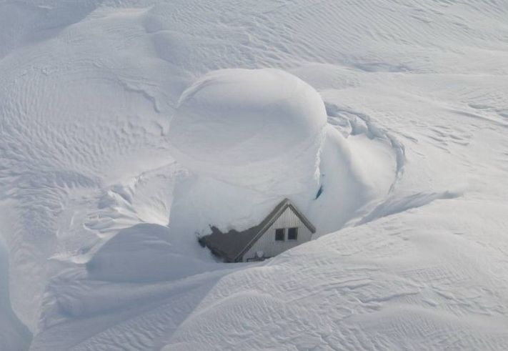
Colorado Impacts
Shorter and warmer winters, with thinner snow pack and earlier runoff
Severe weather events
More wildfires, burning twice as many acres each year than before 1980 (i.e. hydrophobic soil) and runoff events
Notes:
Before we start on the more in depth conversation, I would like to present some basic information on why it is important to think about our impacts. Biggest increases last year of beetle infestation in the state were in Larimer County. 2 degree increase means decrease of 21,000acres of water

Slide 9

Health Connections
  Reductions of 2,615 MT of CO2e (carbon dioxide equivalent) from electricity and natural gas conversion and conservation has significant health benefits.
  Air pollution leads to ozone
  problems and affects asthma and allergy sufferers.
Air pollution avoided:
  300 pounds of nitrogen oxide
  732 pounds of sulfur dioxide
  VOCs
Notes:
Rosa, I don’t get how the stuff you have listed under air pollution are “benefits?”?

Slide 10
Six Americas – Non-Choir
Disengaged (10%):
Simple message with repetition
Use narrative to build emotional connection
Dismissive (10%):
Avoid annoying them
Doubtful (15%):
Use local scientists or physicians

Slide 11




Slide 12
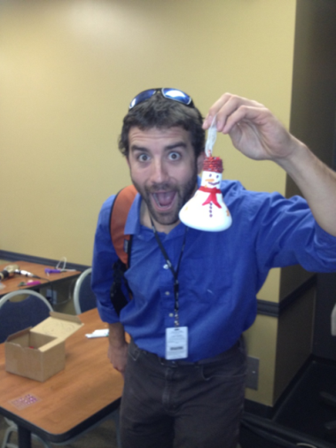
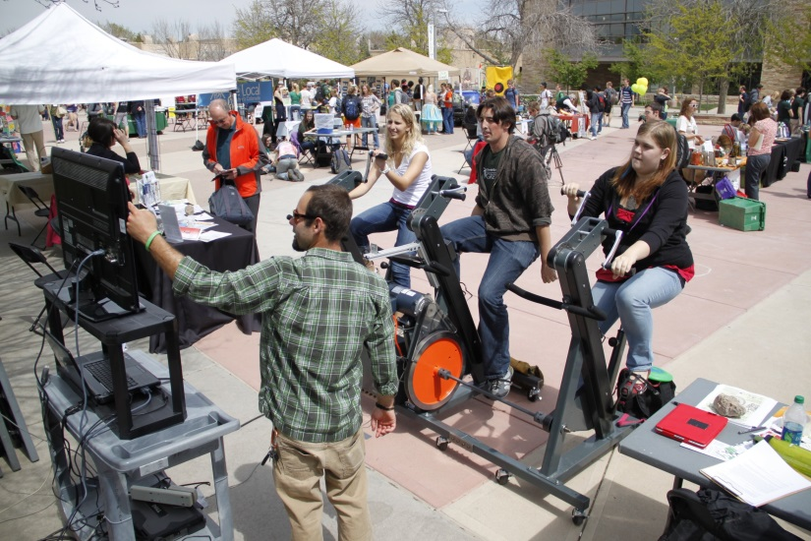
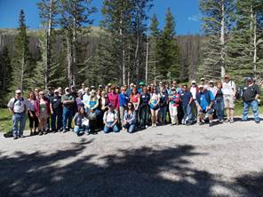
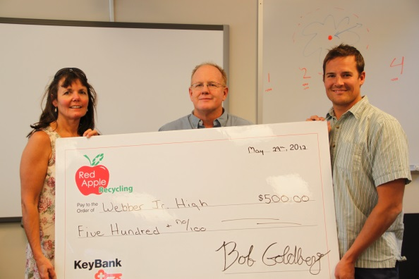
Data, Dashboards …
Our story is not just about facts and figures. It is about people, innovations, partnerships and on-going commitment to do more.

Slide 13

Significance
Each of the last three decades have been successively warmer than any of the preceding decades since 1850.
The ocean has absorbed 30% of the anthropogenic carbon dioxide, causing ocean acidification.
73% of Coloradoans say the issue of global warming is important and 53% want their local governments to do more to address climate change.

Slide 14
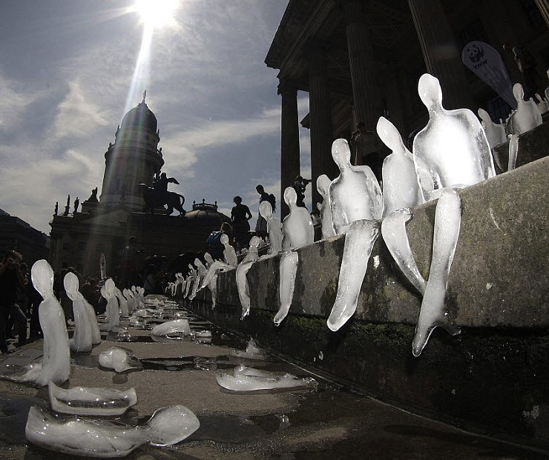
Community-Based Social Marketing & Sustainability
Notes:
*Only have employee commute data for City Hall which has not been input yet, as that is the only LO site that has had to comply with State
Used 2000 as base year & also included 2006 as data was readily available
Waste area is also a bit less “solid” as data is based number, size and type of containers hauler removes weekly so volumes and types of waste are approximate.

Slide 15
Community Based Social Marketing
Information-intensive approaches such as bill-stuffers, flyers and direct mail have little likelihood of changing behavior.
Individuals will engage in behavior if its part of a social norm ( i.e. challenge, pledge)
Pledges should have more than environmental benefits listed (i.e. TBL).
Public and signed commitments increase participation rates.

Slide 16
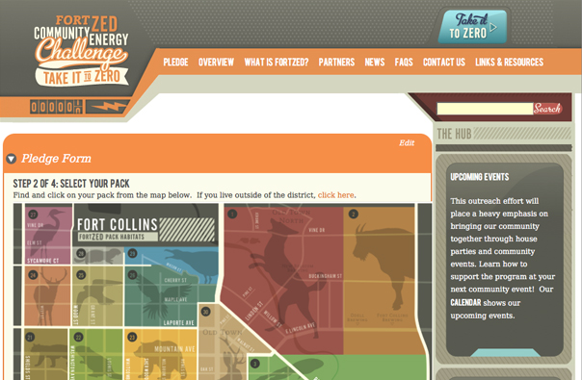

It Takes a Village …
The Atmosphere Conservancy, CW businesses, City staff and students assisted in developing the neighborhood packs.

Slide 17

ClimateWise (CW) Program
Since 2000, over 350 CW business partners have saved over one million dollars and avoided 163,000 metric tons of carbon emissions.
The City and CSU gained CW Platinum status through various leadership links such as networking, collective challenges, outreach coordination and sharing technical expertise.

Slide 18
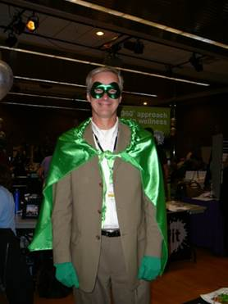
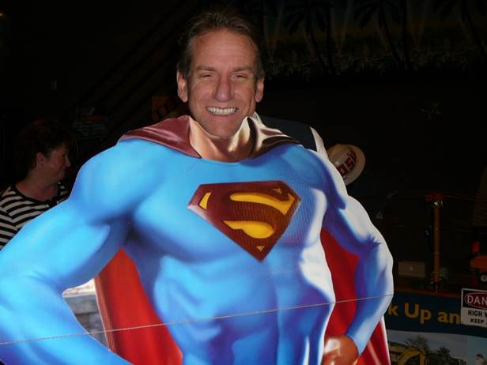
Challenges
Use pledge cards
(electronically and hard copies)
Track cumulative environmental, economic and social benefits;
Competition among departments and Poudre Fire Authority stations
Provide prompts and solicit feedback
Enter participants in drawing for “educational prizes”
Report back on the savings

Slide 19
Background Information
Fixtures and Fittings
Potable | Gallons per Capita/Day
Showers | 11.6
Dishwasher | 1.0
Faucets | 10.9
Other uses (leaks) | 11.1
Non Potable
Washers | 15
Toilets | 18.5
Outdoor Use | 95.7
Notes:
Source: American WaterWorks Association Research Foundation - gallons per capita column
Source: LEED Water Efficiency BDC
Showerheads 2.75 to 1.75 – 7700 gpy - 25-60% Aerators 3.0 to 1.5 = 17700 gpy - $100 yr

Slide 20
Action — Take 10 | Pounds of C0₂e Avoided | $ Saved Per Year
1. Avoid driving 20 miles per week. | 850 | $166
2. Request the smallest trash container and larger recycling bin. (100% capacity) | 12,000 | $ 96
3. Ditch your dryer—50% reduction . | 760 | $ 40
4. Install 4 CFLs. | 650 | $ 28
5. Participate in renewable wind program. Visit: fcgov.com/utilities. ** (Cost to enroll: $84) | 7,796 | **
6. Wash clothes in cold water. | 230 | $ 12
7. Set computer & monitor to sleep at night . | 200 | $ 10
8. Garden—1 meal (30 days x 3 months) | 68 | $480
9. Don’t idle (5 minutes/day) | 18 | $ 30
10. Plant a native tree (1/3 electricity/4months) | 128 | $120
ANNUAL SAVINGS | 22,700 | $982

Slide 21
Leading Change
Use resources: new Environmental Portal – fcgov.com/enviro and Green It, Mean It website.
Acknowledge staff that maintains LEED, ISO or professional credential through CEUs .

Slide 22
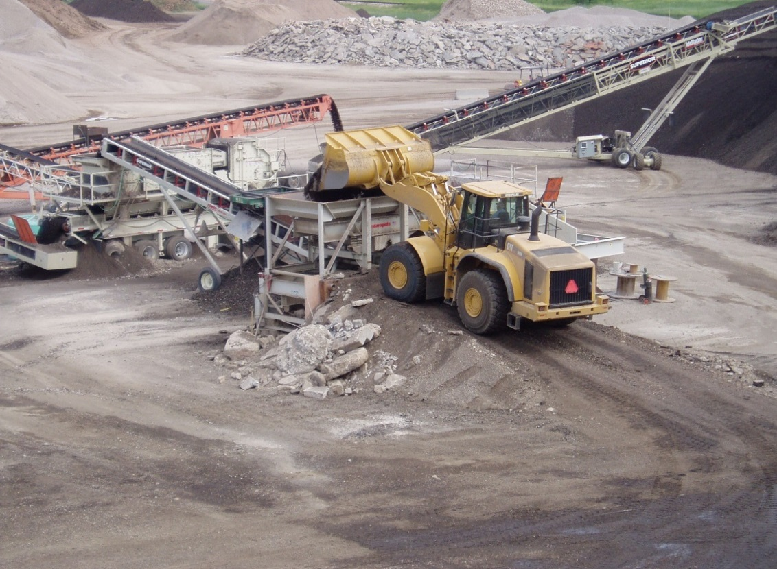
Strategic Programs
Pave our Streets in …………….
Water Treatment Plant has a solar farm….

Slide 23

Conservation Culture
Water Conservation
Tier Rates
Depth and Breadth
VISION
BizED and Residential
MISSION
Water Festival
VALUES
WaterWise
Rebates
Notes:
Once a picture of the Strategy Story was complete, we refined the strategy map to reflect a horizontal view of the strategy, less hierarchical. This Strategy maps reflects similar components of the 2012 Strategy Map:
We still listen to our customers and stakeholders, and are driven by the Mission, Vision and Values.
We organized our strategy around “our work”, or the Key Outcomes of what we have committed to the community (name the outcome areas).
We described the purpose each Key Outcome in the Strategic Objective. (read one of the Key Outcomes and Strategic Objective that relates to the team you are presenting to as an example). For example, the “outcome” of a High Performing Government is that we “Deliver an efficient, innovative, transparent, effective and collaborative city government”
In order to meet our Strategic Objective, we created Strategic Goals for each of the Key Outcomes. Initiatives are the actions we will complete in the next 1-2 years. The Initiatives directly relate to the work we do each day.
Have a handout of the strategic plan and refer to the Strategic Goals and Initiatives. Highlight a couple of the Strategic Goals that relate to the department you are presenting to.
Note the final link in the flow is the department and individual goals. This is where the real work gets done! Communication and input flows both ways- from departments, teams and individuals to the broader organization, and from the organization to the teams and individual contributors.

Slide 24

Resources
1.
2.
AASHE, USDN
3.
4.
Fostering Sustainable Behavior

Slide 25


values
Customer Service OR Sustainability
Walking the Talk and Resourcing it….

Slide 26
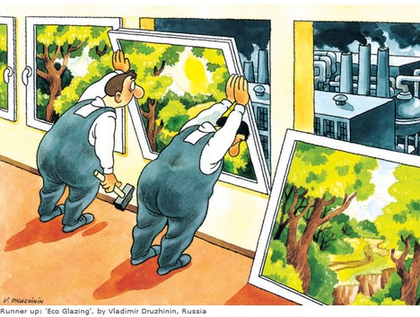
THOUGHTS?
Acknowledge Challenges ……
Work with business and residential …..
Thanks…….

